Slide 1


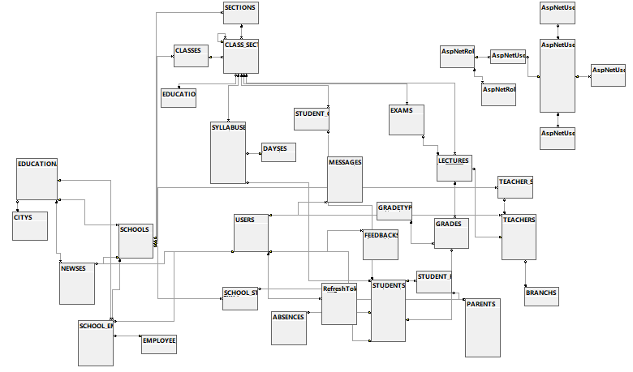
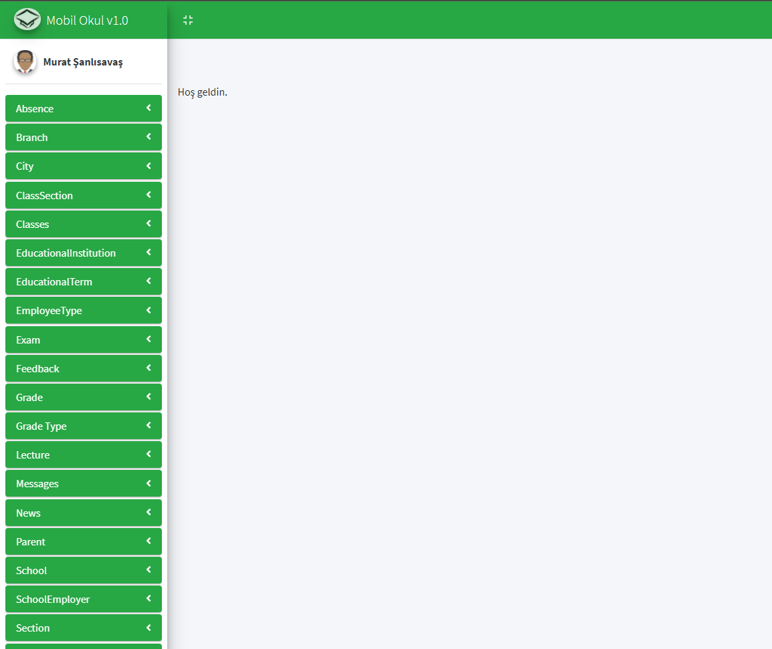
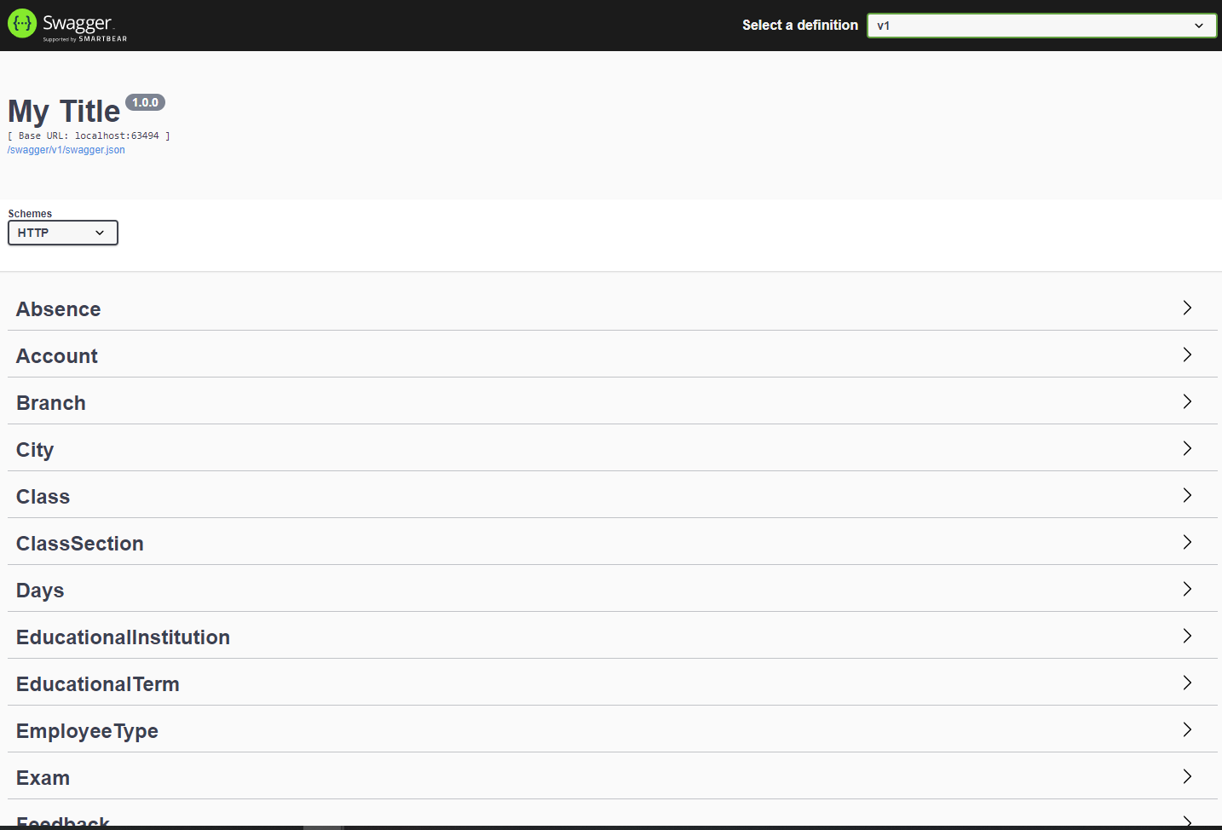
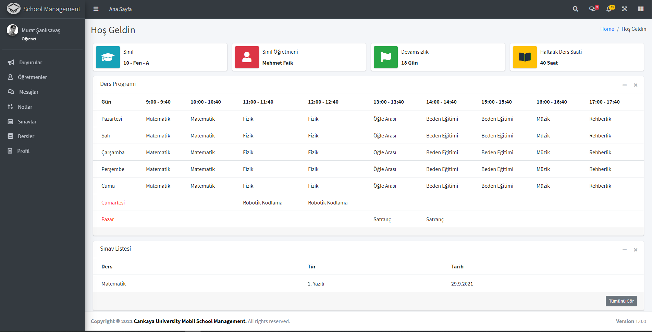
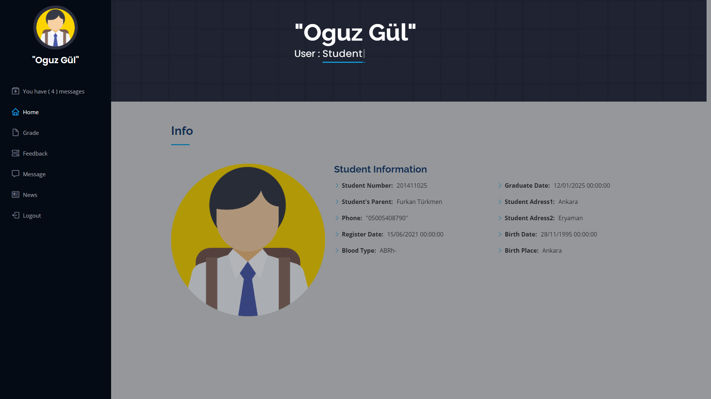
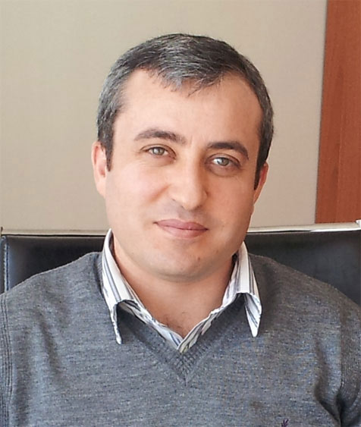




MOBILE SCHOOL MANAGEMENT SYSTEM
Dr.Öğr.Üyesi Murat SARAN
Oğuz GÜL – Burak GÜNEŞ
Furkan TÜRKMEN – Murat ŞANLISAVAŞ
Çankaya University, Department of Computer Engineering
Abstract
In today's world the usage rate of mobile devices are constantly increasing in all kinds of educational areas. This report expresses the need for an application in such areas of education. This project will be named Mobile School Management System and its aim is to create a bridge between Educational Institutions and Student-Parent-Teacher-Administrative Employee. School Management System will be a mutual portal for students, parents, teachers, and IT personnel. The project will ease the process of communication with students, teachers and parents.
Figure 1 – Database
Introduction
School Management System consists of three different project which are API(Data Layer), Management Interface, and School Portal. API is a bridge between data and its consumers and being protected by JWT Token and Role Management. Management Interface is the place where all the initialization happens. Everything in the database can be created from this interface. School portal is the place where students, parents and teachers meet. Information about lectures, exams, syllabus, announcements, absences, teachers and many more are on this project. Students, teachers and parents can message, share, inform from the system.
Figure 5 – Finished Web Admin Side
Results & Conclusion
At the start we have made ourselves a road map to follow through all the way to the end. First, we have built our database to cover every feature. After that we made our entities according to our design. Next, we made the API project. We programmed this project as generic as possible. After having a fully working REST API we were ready to consume the API. We built our second project Admin Interface. This project aimed to create, delete, list and edit every database element. Lastly, we built our last project School Portal where students, teachers and parents can interact with each other. We made this project as simple as possible. What we mean by simple is that all the information supposed to be seen by its users are on a single page and can be expanded into detailed forms. We have faced many difficulties securing our project. To secure the API we used JWT Token Authentication. To consume the API users needs to be validated by JWT tokens. Also, every user have their roles. We use these roles to decide if a user has permission to do CRUD operations. We have faced many difficulties through out the project and got over all of them. All these difficulties made us a lot experienced on the multi platform web applications.
Figure 2 – Finished Web API
Solution
There are not many applications that handle school management like our project. In today's world the schools usually send information via SMS or E-mail services. These services are generally One-way. This means they are usually about an announcement and don't require any response from the receiver side. This makes the sender side wondering if the receiver even received that message or if they agree about what the message presents. Our goal is to create the bridge between the school's management and the end users just like teacher, student, parent. Users will be able to get every information they need from this application. For example, the parents will be able to check their child's attendance, exam notes, check news about the school or the class, get announcements, solve surveys about the school or the teacher, check their child's syllabus etc.
Acknowledgement
We thank our advisor Murat SARAN for asistance during the development of the project.
Figure 3 – Finished Web User Side
Figure 5 – Group Members
Advisor Dr. Öğr. Üyesi Murat SARAN
Figure 4 – Finished Web User Side
Burak Emrullah
GÜNEŞ
Oğuz
GÜL
Furkan
TÜRKMEN
Murat ŞANLISAVAŞ

